Slide 1

Bonifacio Global City (BGC) Bus Passenger Information System: Bus Tap
ALCARAZ, ANNA LYNN C.
ANGOT, SAMMY BOY M.
BESMANO, JUSTIN V.
BRIOSO, JOB G.

Slide 2
Introduction

Slide 3
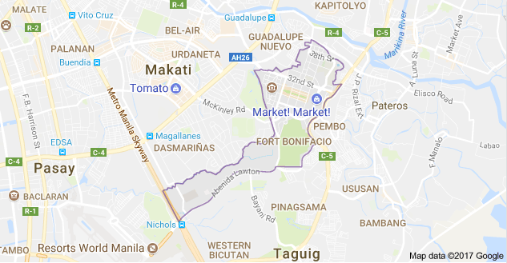
Bonifacio Global City (BGC)

Slide 4
BGC Bus
North Express
North Route
East Express
Central Route
Upper West Express
Lower West Express
Night Route
West Route
East Route
Ayala Express
Arca South Express
Nuvali Express

Slide 5
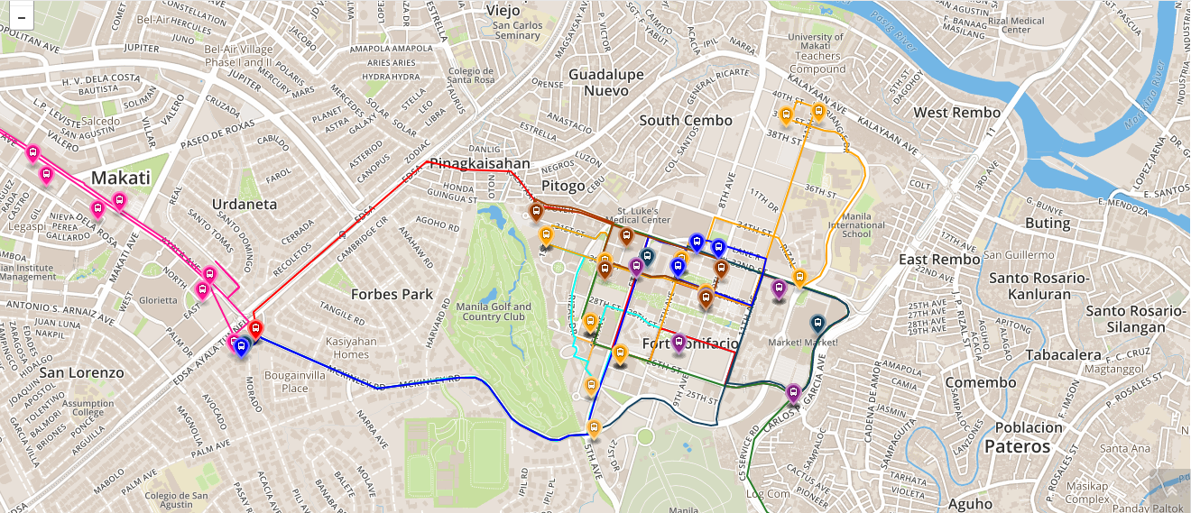
Bus Routes

Slide 6
Operating Schedule
Routes | Day | Time
North Express | Mondays to Fridays only | 6:00AM to 10:00PM
North | Mondays to Fridays only | 6:30AM to 10:00AM and 4:30PM to 8:30 PM
East Express | Mondays to Fridays only | 6:00AM to 10:00PM
Central | Everyday | 6:00AM to 10:00AM
Upper West Express | Mondays to Fridays only | 6:00AM to 10:00PM
Lower West Express | Mondays to Fridays only | 6:00AM to 10:00PM
Night | Everyday | 10:00PM to 6:00 AM
East | Weekends | 6:00AM to 10:00PM
West | Weekends | 6:00AM to 10:00PM
Ayala Express | Mondays to Fridays only | 7:00AM to 10:00AM
Arca South Express | Mondays to Fridays only | 6:10AM to 9:00AM and 4:00PM to 8:00 PM
Nuvali Express | Mondays to Fridays only | 6:30AM, 6:30PM, and 7:15PM

Slide 7


Bus Fare
Php 12.00 for all routes, except Arca South and Nuvali
Tickets are not sold on board a BGC Bus.
Buy tickets at a cashier counter at selected stops and terminals.
Pay using their tap-and-go beep cards.

Slide 8
Existing Apps

Slide 9
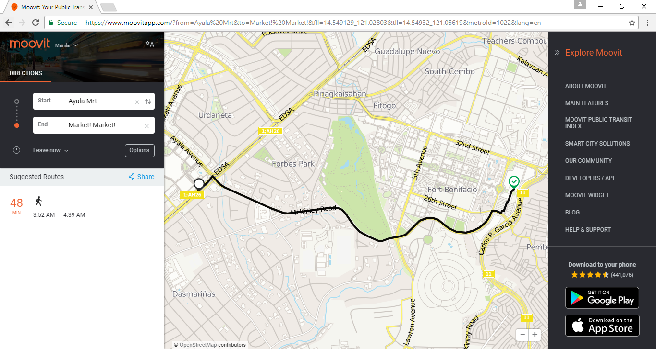
Existing Apps: Moovit

Slide 10
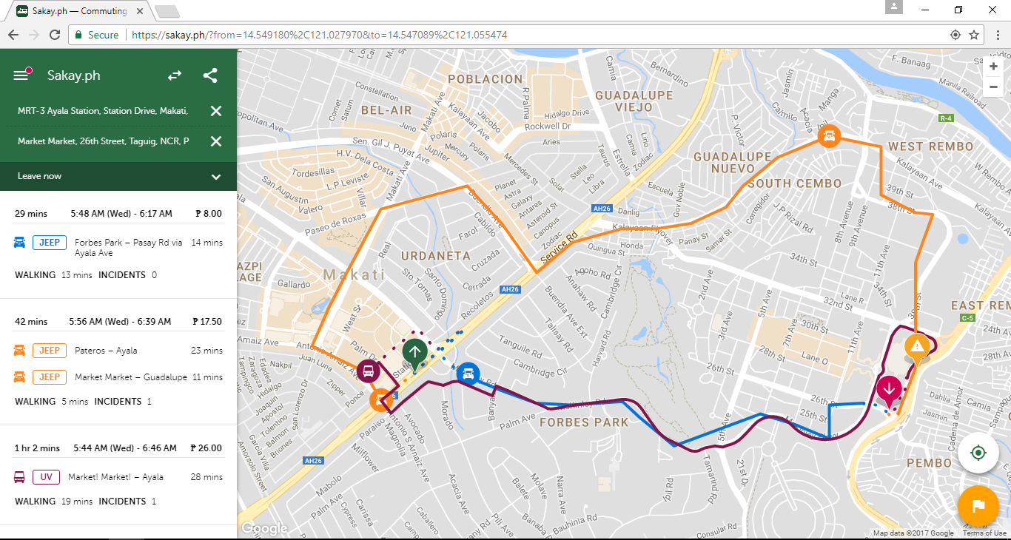
sakay.ph
Existing Apps: Sakay.ph

Slide 11
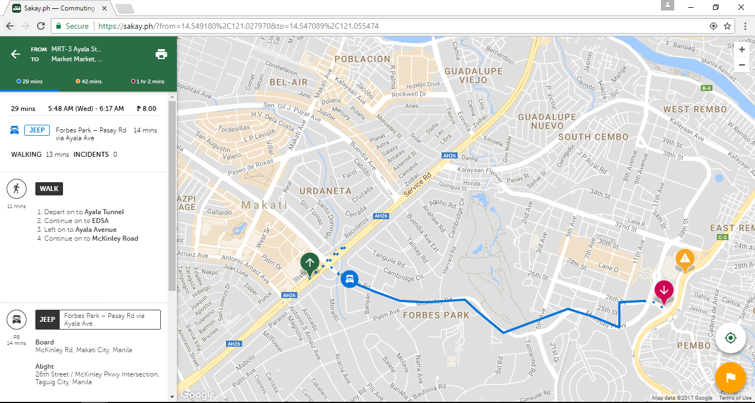
sakay.ph
Existing Apps: Sakay.ph

Slide 12
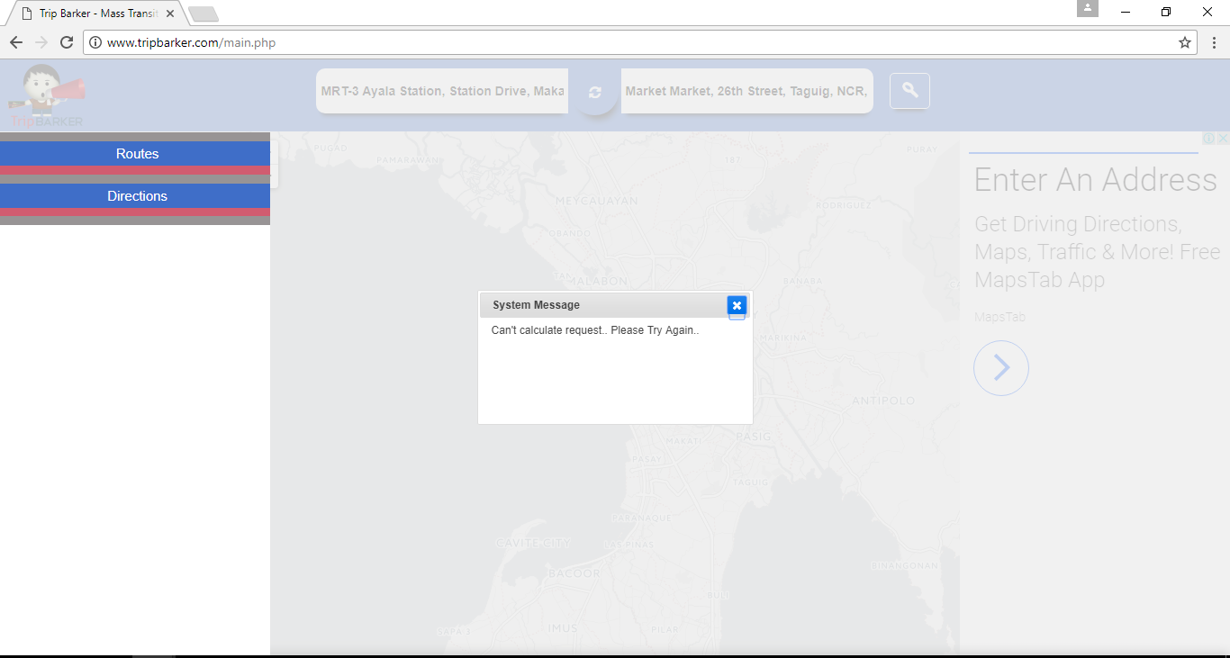
TripBarker
Existing Apps: Trip Barker

Slide 13
Existing Apps
 | Moovit | sakay.ph | TripBarker
Web URL | https://www.moovitapp.com | https://sakay.ph | http://www.tripbarker.com
Google Play Store | ✔ | ✔ | ✔
Apple App Store | ✔ | ✔ | ✖

Slide 14
Bus Tap

Slide 15
Objectives
The Bus Tap aims to be able to:
provide relevant information regarding the BGC Bus;
decrease the waiting time of passengers riding the BGC Bus; and
help users navigate their way around Bonifacio Global City using the BGC Bus.

Slide 16
Features
Detailed Itineraries
– 66% of the BGC Bus passengers will find this feature useful
GPS for transit
Step-by-step guidance from origin to destination
Estimated travel time
Fare
Get Off Alerts

Slide 17
Features
Bus Routes, Bus Stops, Points of Interest – 66%
Operation Status, Operating Schedule, Announcements
Arrival Times and Departure Times – 75%
Estimated Time of Arrival – 50%
Bus Locator – 58%
Reservation (limited to select bus stops and terminals)

Slide 18
Features Comparison
Features | Moovit | sakay.ph | TripBarker | Bus Tap
Commuting routes | ✔ | ✔ | ✔ | ✔
BGC Bus information (e.g. routes, stops, operating schedule, fare) | ✖ | ✖ | ✖ | ✔
Arrival and departure times | ✖ | ✖ | ✖ | ✔
ETA of next bus | ✖ | ✖ | ✖ | ✔
Bus location | ✖ | ✖ | ✖ | ✔
Seat reservation | ✖ | ✖ | ✖ | ✔

Slide 19
Scope and Limitations
mobile (for passengers and drivers)
web (for employees)
for Android devices only
for BGC Bus only
limited to within BGC and select areas of Taguig City (Arca South Express), Makati City (Ayala Express), and Sta. Rosa, Laguna (Nuvali Express)

Slide 20
UML Diagrams

Slide 21
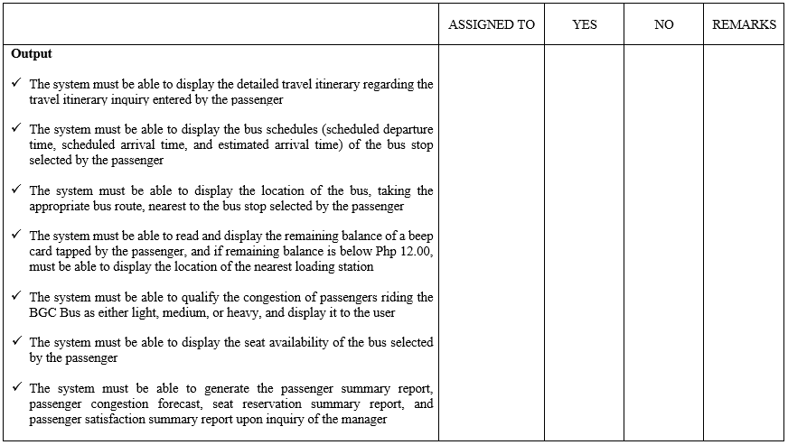
Software Requirements Specification (SRS)

Slide 22
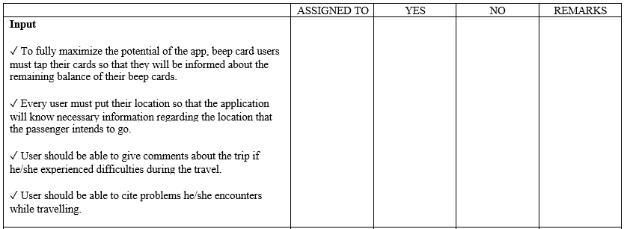
Software Requirements Specification (SRS)

Slide 23
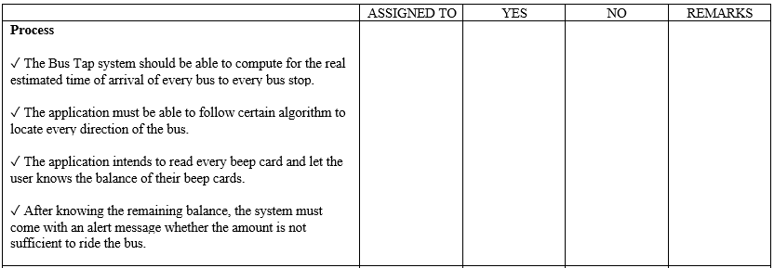
Software Requirements Specification (SRS)

Slide 24
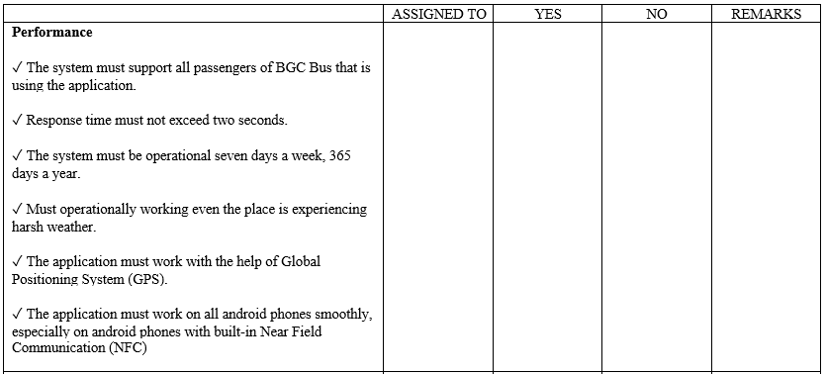
Software Requirements Specification (SRS)

Slide 25
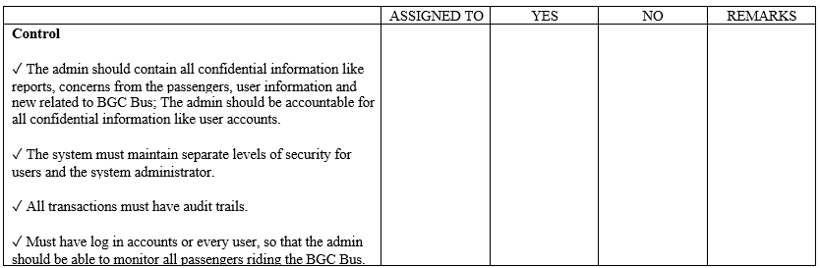
Software Requirements Specification (SRS)

Slide 26
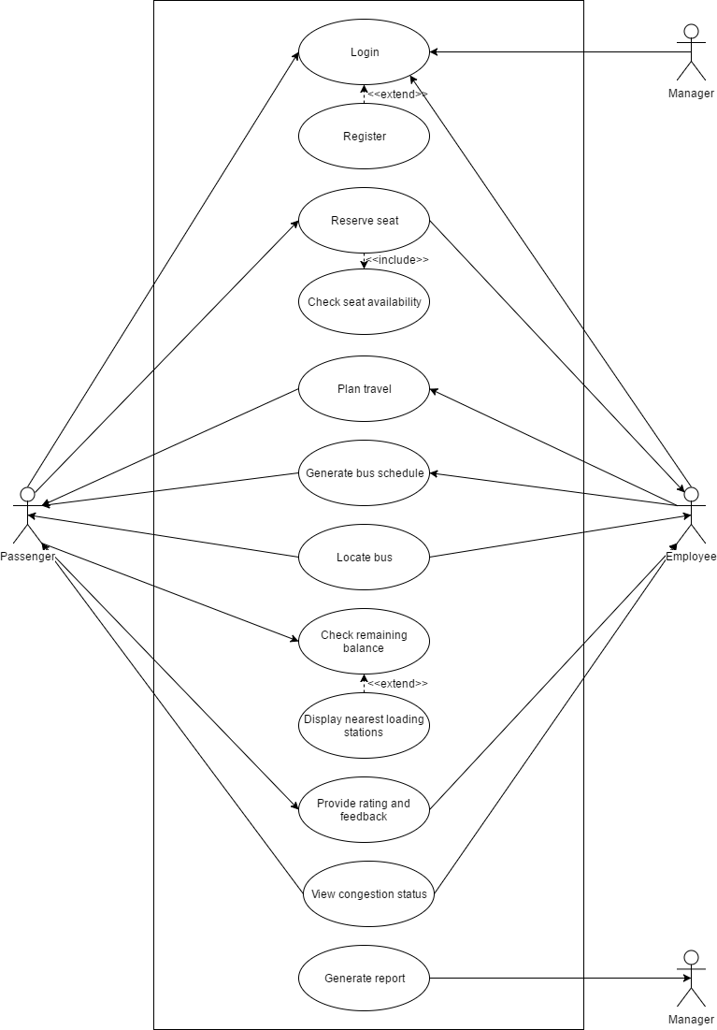
Use Case Diagram

Slide 27
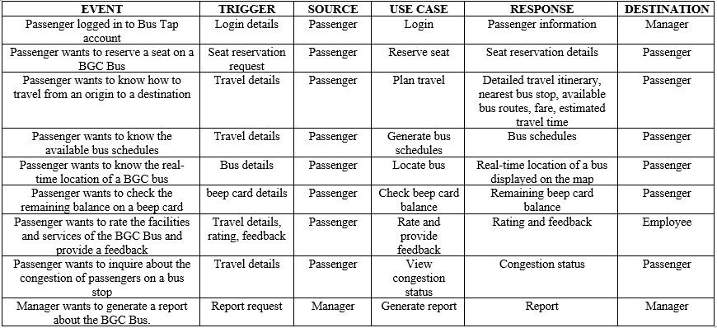
Event Table

Slide 28
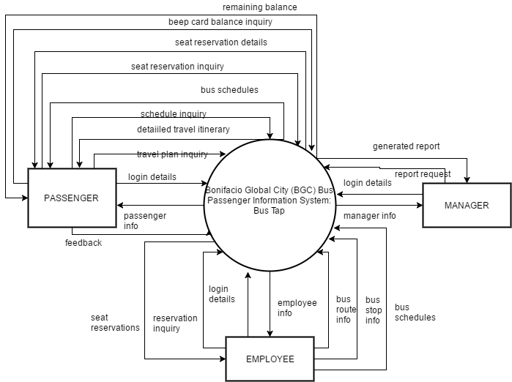
Data Flow Diagram
Context Diagram

Slide 29
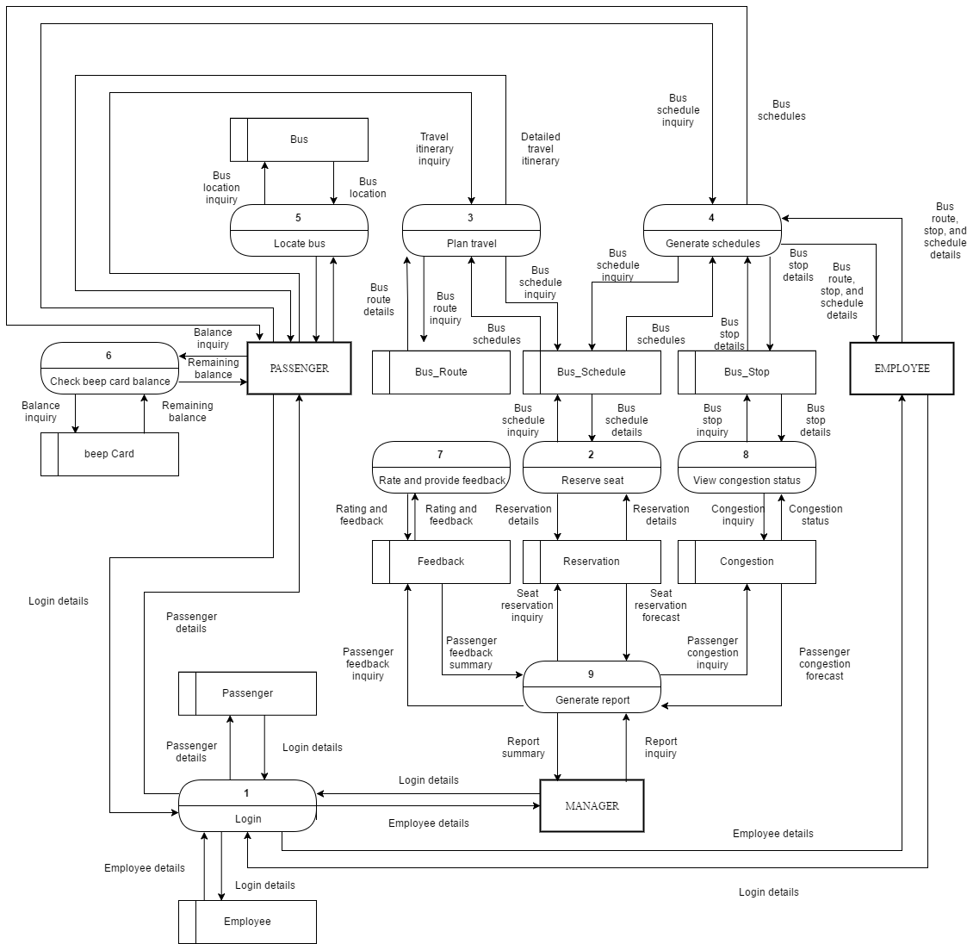
DFD Level 1

Slide 30
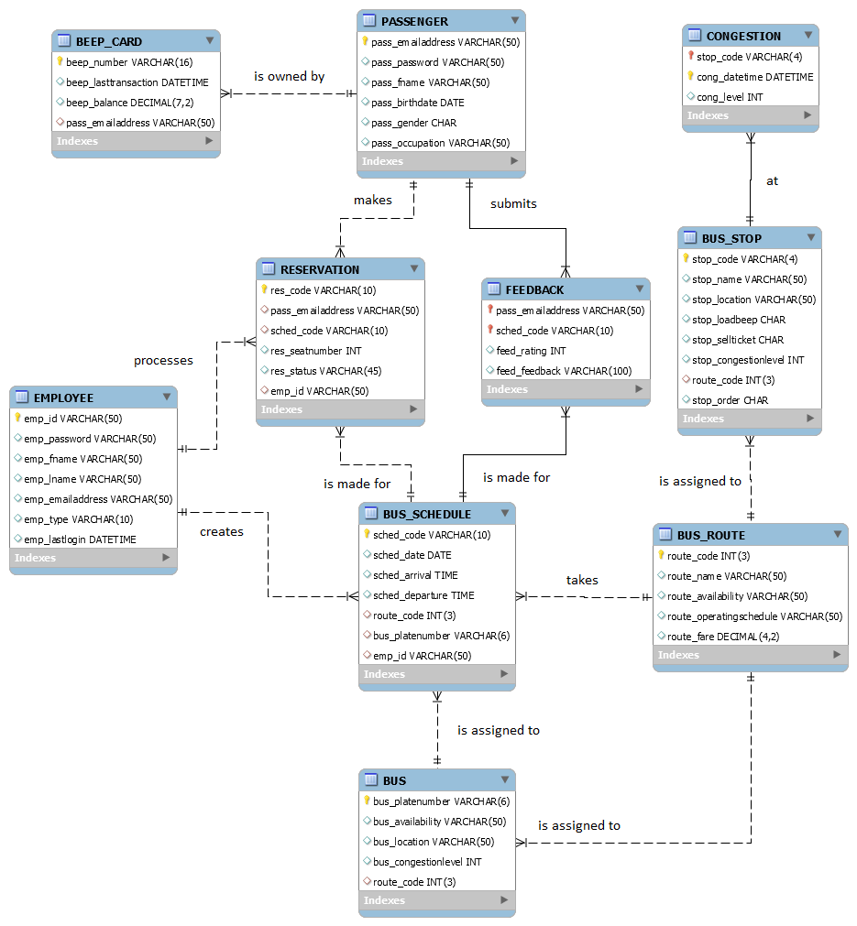
Entity Relationship Diagram (ERD)

Slide 31
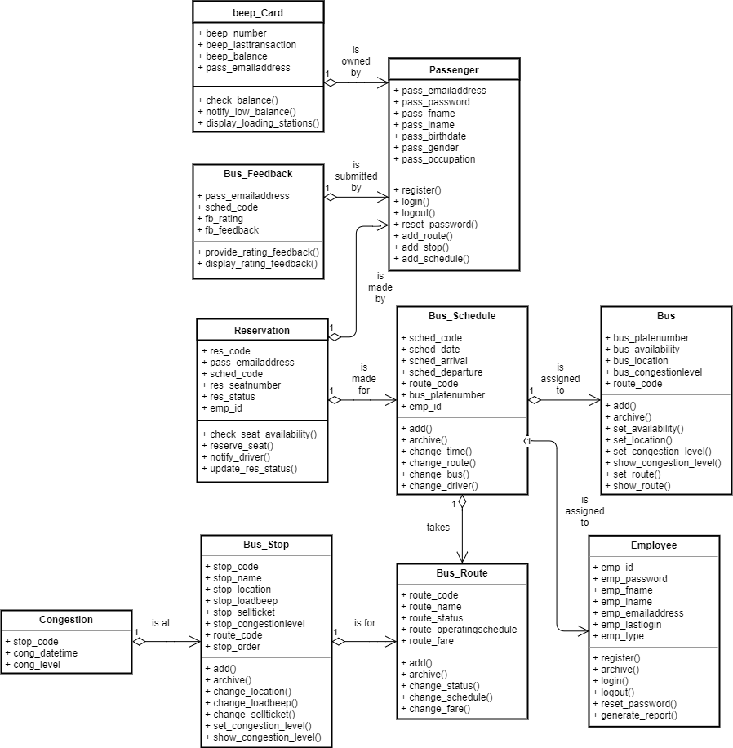
Class Diagram

Slide 32
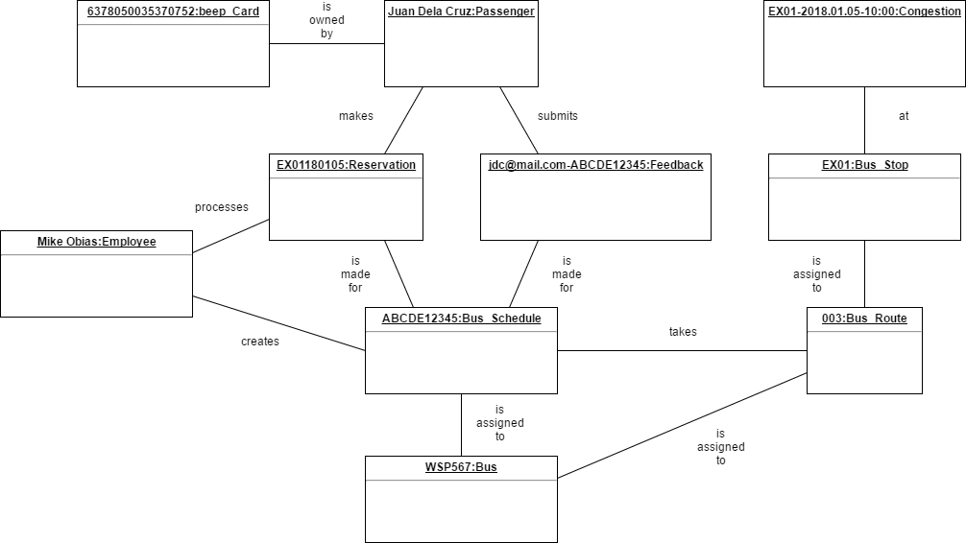
Object Diagram

Slide 33
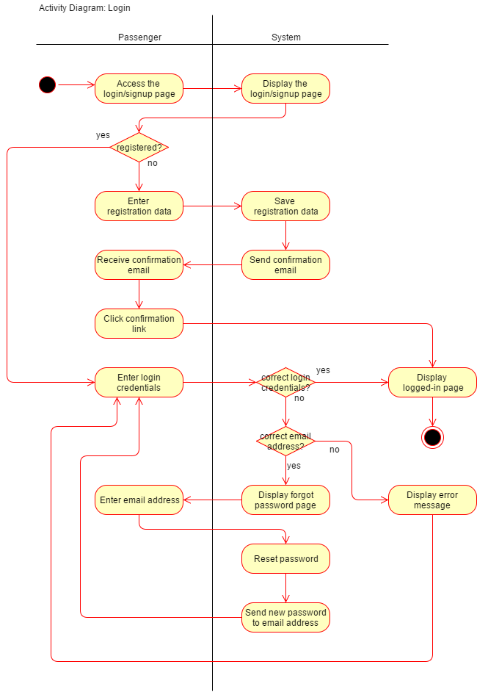
Activity Diagram: Login

Slide 34
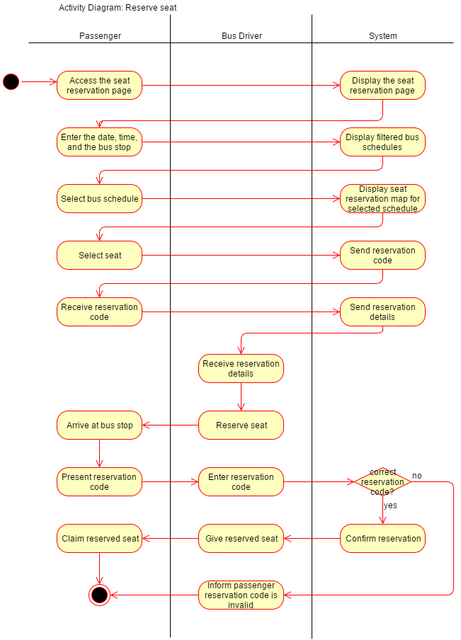
Activity Diagram: Reserve seat

Slide 35
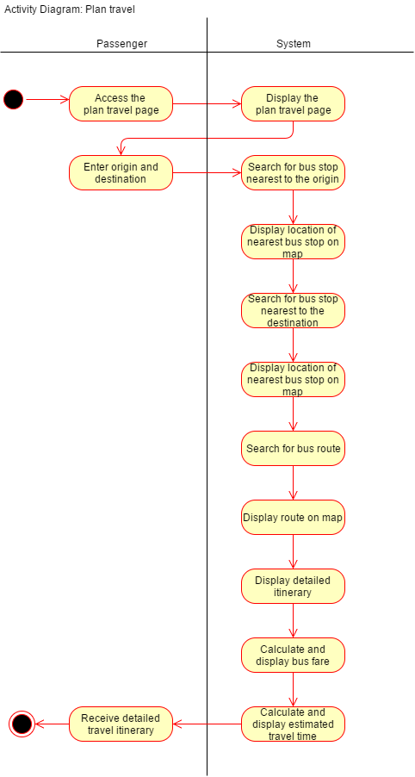
Activity Diagram: Plan travel

Slide 36
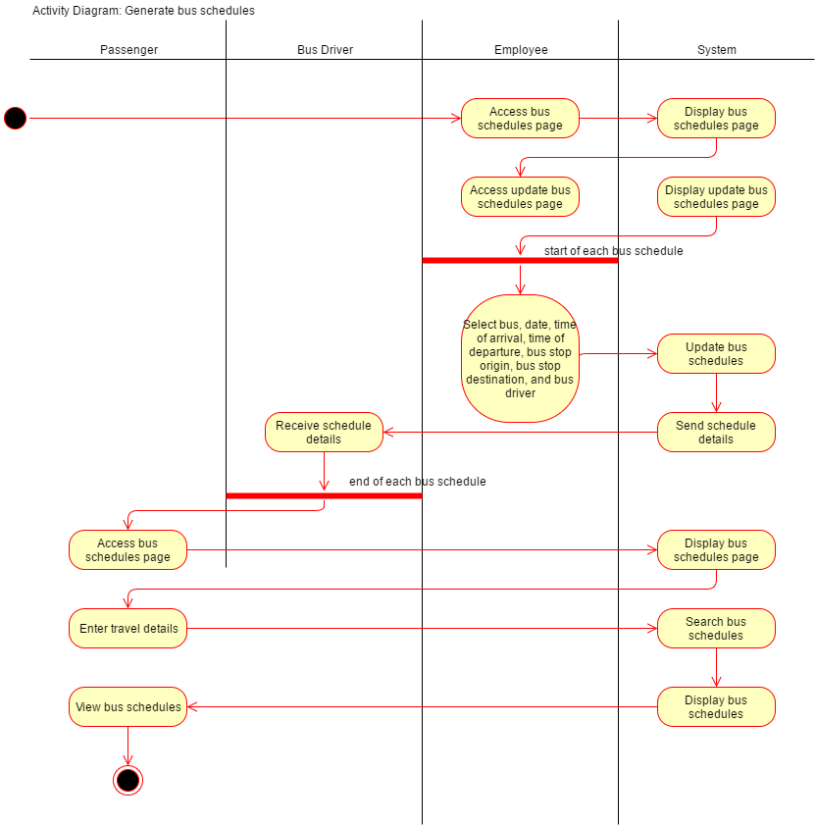
Activity Diagram: Generate bus schedules

Slide 37
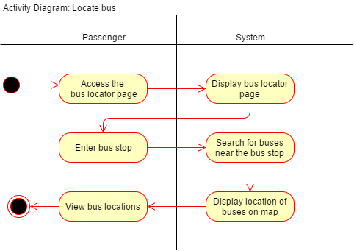
Activity Diagram: Locate bus

Slide 38
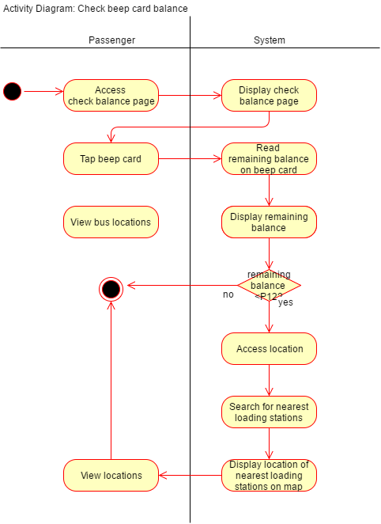
Activity Diagram: Check beep card balance

Slide 39
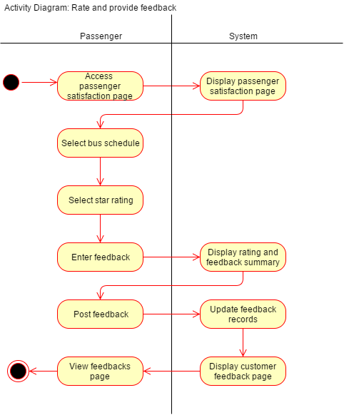
Activity Diagram: Rate and provide feedback

Slide 40
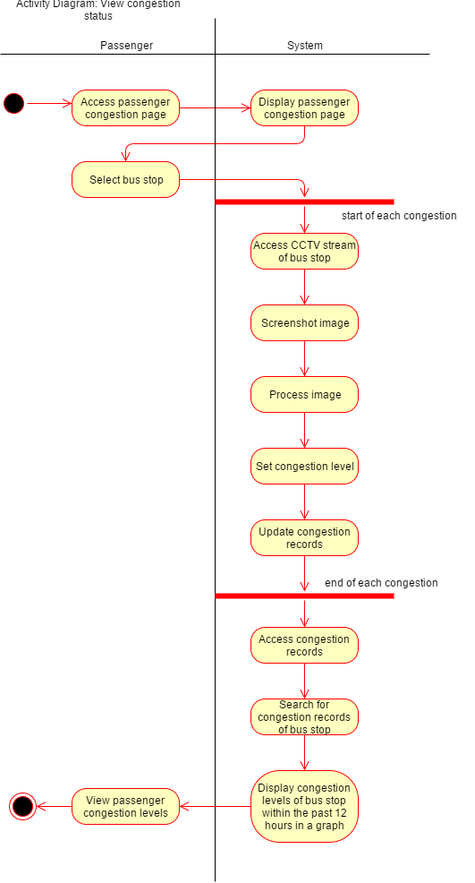
Activity Diagram: View congestion

Slide 41
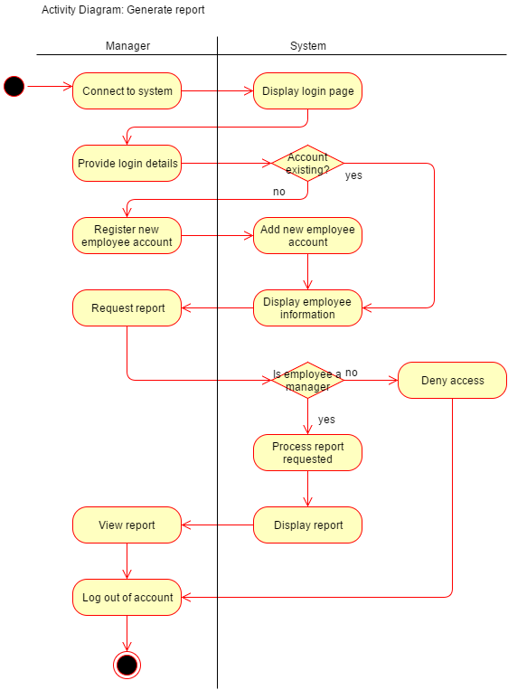
Activity Diagram: Generate report

Slide 42
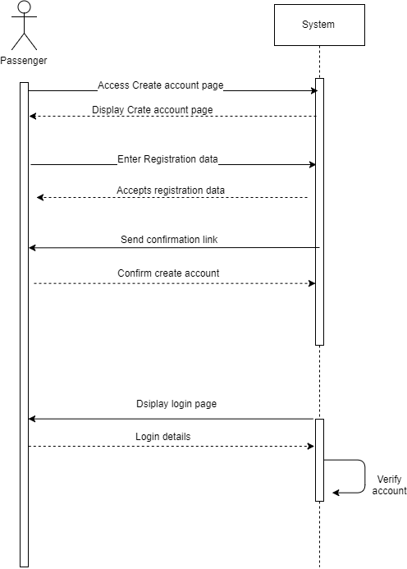
Sequence Diagram: Login

Slide 43
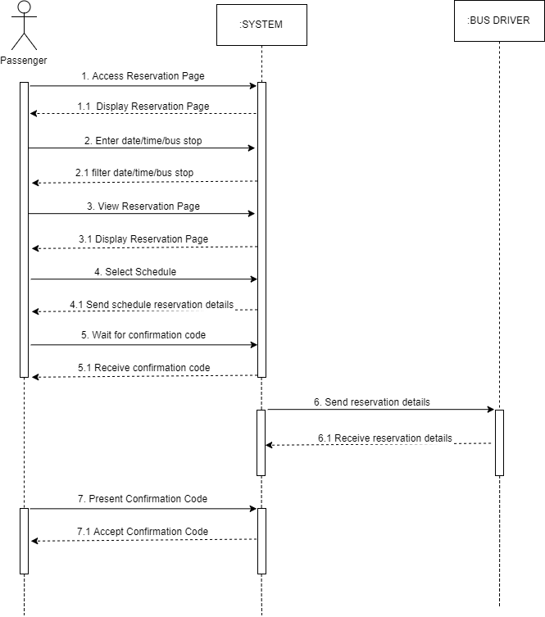
Sequence Diagram: Reserve seat

Slide 44
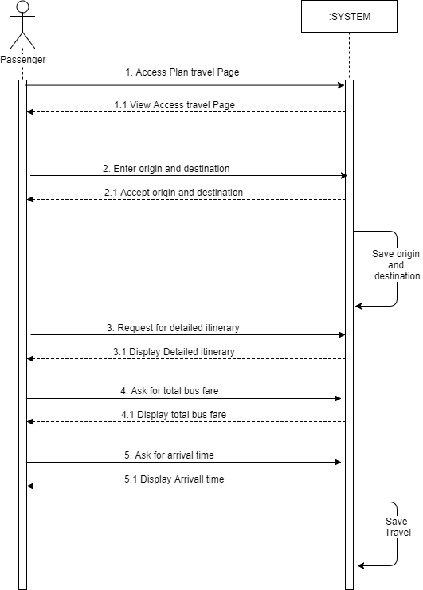
Sequence Diagram: Plan travel

Slide 45
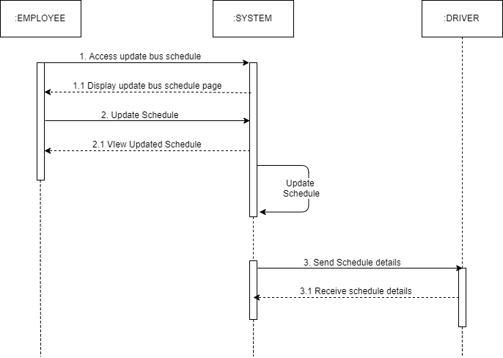
Sequence Diagram: Generate bus schedules (employee)

Slide 46
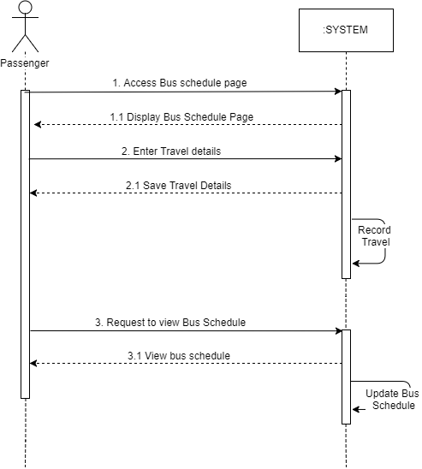
Sequence Diagram: Generate bus schedules (passenger)

Slide 47
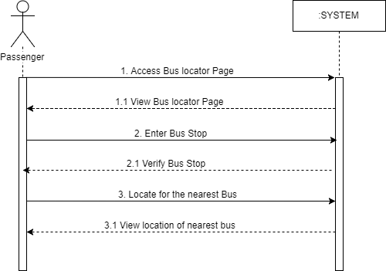
Sequence Diagram: Locate bus

Slide 48
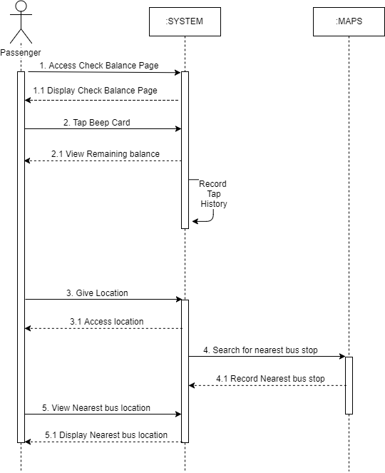
Sequence Diagram: Check beep card balance

Slide 49
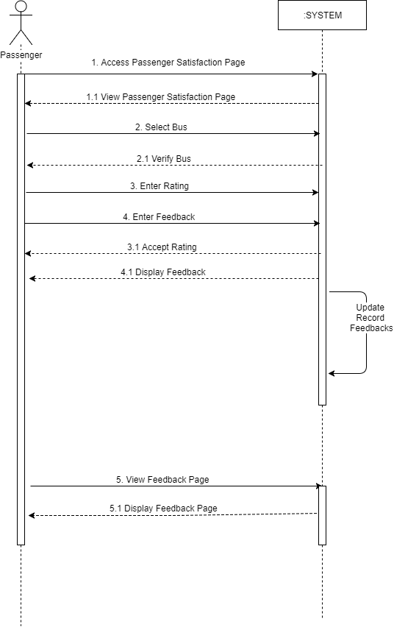
Sequence Diagram: Rate and provide feedback

Slide 50
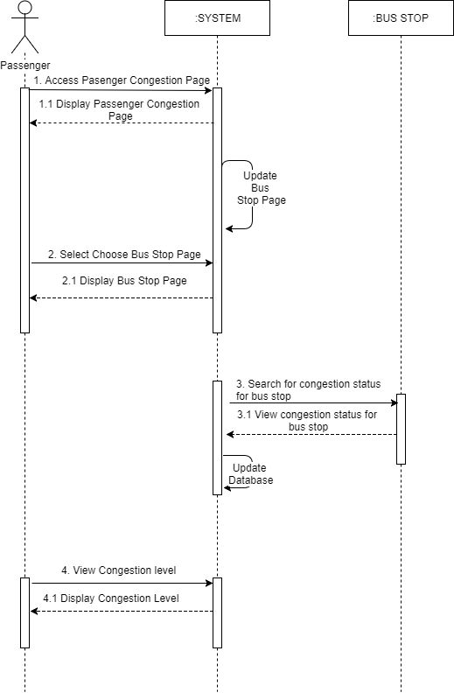
Sequence Diagram: View congestion status

Slide 51
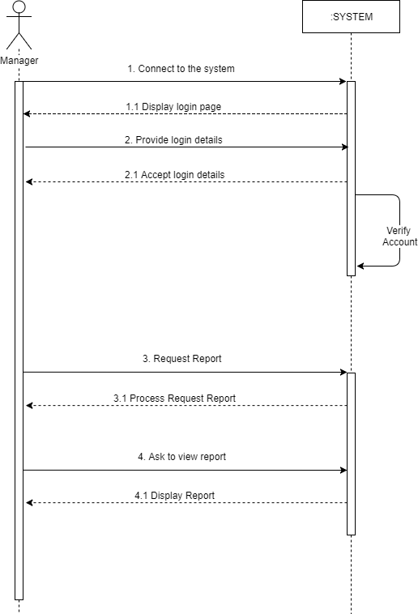
Sequence Diagram: Generate report

Slide 52
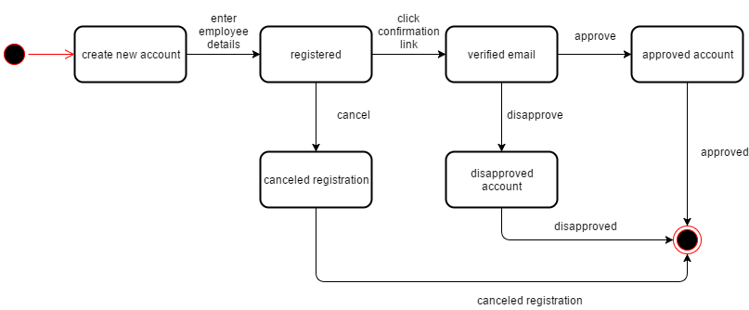
State Diagram: Passenger and Employee

Slide 53
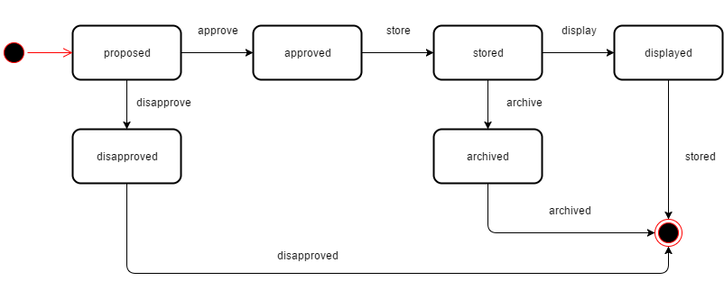
State Diagram: Bus Route and Bus Stop

Slide 54
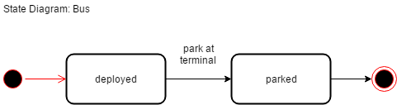
State Diagram: Bus

Slide 55
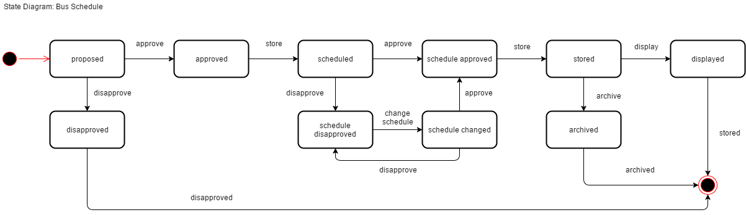
State Diagram: Bus Schedule

Slide 56
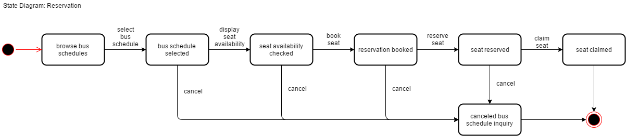
State Diagram: Reservation

Slide 57
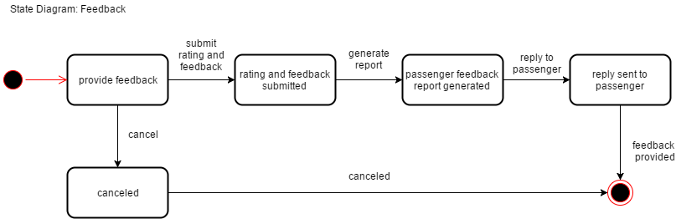
State Diagram: Feedback

Slide 58
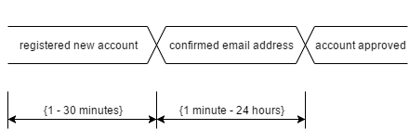
Timing Diagram: Passenger and Employee

Slide 59
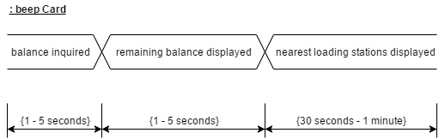
Timing Diagram: beep Card

Slide 60
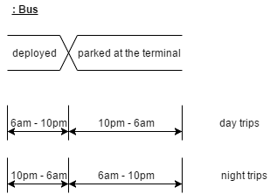
Timing Diagram: Bus

Slide 61
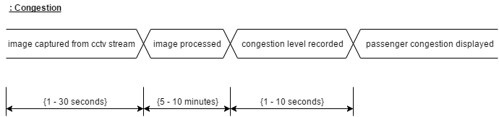
Timing Diagram: Congestion

Slide 62
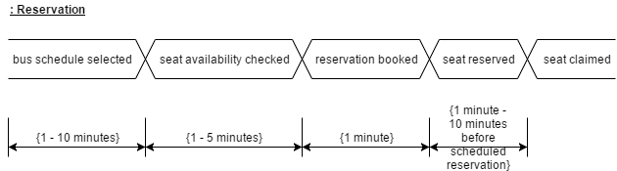
Timing Diagram: Reservation

Slide 63
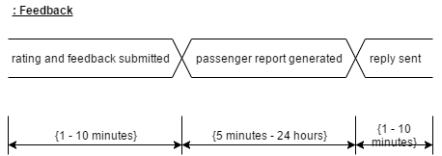
Timing Diagram: Feedback

Slide 64
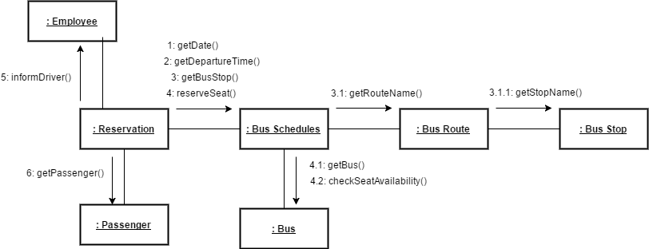
Communication Diagram: Reserve seat

Slide 65

Communication Diagram: Plan travel

Slide 66

Communication Diagram: Display bus schedules

Slide 67

Package Diagram

Slide 68

Component Diagram

Slide 69

Deployment Diagram

Slide 70

Composite Structure Diagram

Slide 71
Thank you

Slide 72

Functional Description Diagram (FDD)

Slide 73

Full Use Case Description

Slide 74

Full Use Case Description

Slide 75

Full Use Case Description

Slide 76

Full Use Case Description

Slide 77

Full Use Case Description

Slide 78

Full Use Case Description

Slide 79

Full Use Case Description

Slide 80

Full Use Case Description

Slide 81
Data Dictionary
ENTITY: BEEP_CARD
Attribute Name | Data Type
beep_number | VARCHAR(16)
beep_lasttransaction | DATETIME
beep_balance | DECIMAL(7,2)
pass_emailaddress | VARCHAR(50)

Slide 82
Data Dictionary
ENTITY: PASSENGER
Attribute Name | Data Type
pass_emailaddress | VARCHAR(50)
pass_password | VARCHAR(50)
pass_fname | VARCHAR(50)
pass_lname | VARCHAR(50)
pass_birthdate | DATE
pass_gender | CHAR
pass_occupation | VARCHAR(50)

Slide 83
Data Dictionary
ENTITY: RESERVATION
Attribute Name | Data Type
res_code | VARCHAR(10)
pass_emailaddress | VARCHAR(50)
sched_code | VARCHAR(10)
res_seatnumber | INT
res_status | VARCHAR(45)
emp_id | VARCHAR(50)

Slide 84
Data Dictionary
ENTITY: FEEDBACK
Attribute Name | Data Type
pass_emailaddress | VARCHAR(50)
sched_code | VARCHAR(10)
feed_rating | INT
feed_feedback | VARCHAR(100)

Slide 85
Data Dictionary
ENTITY: BUS
Attribute Name | Data Type
bus_platenumber | VARCHAR(6)
bus_availability | VARCHAR(50)
bus_location | VARCHAR(50)
bus_congestionlevel | INT
route_code | INT(3)

Slide 86
Data Dictionary
ENTITY: BUS_SCHEDULE
Attribute Name | Data Type
sched_code | VARCHAR(10)
sched_date | DATE
bus_platenumber | VARCHAR(6)
route_code | INT(3)
sched_arrival | TIME
sched_departure | TIME
emp_id | VARCHAR(50)

Slide 87
Data Dictionary
ENTITY: EMPLOYEE
Attribute Name | Data Type
emp_id | VARCHAR(50)
emp_password | VARCHAR(50)
emp_fname | VARCHAR(50)
emp_lname | VARCHAR(50)
emp_emailaddress | VARCHAR(50)
emp_type | VARCHAR(10)
emp_lastlogin | DATETIME

Slide 88
Data Dictionary
ENTITY: BUS_ROUTE
Attribute Name | Data Type
route_code | INT(3)
route_name | VARCHAR(50)
route_availability | VARCHAR(50)
route_operatingschedule | VARCHAR(50)
route_fare | DECIMAL(4,2)

Slide 89
Data Dictionary
ENTITY: BUS_STOP
Attribute Name | Data Type
stop_code | VARCHAR(4)
stop_name | VARCHAR(50)
stop_location | VARCHAR(50)
stop_loadbeep | CHAR
stop_sellticket | CHAR
stop_congestionlevel | INT
route_code | INT(3)
stop_order | INT

Slide 90
Data Dictionary
ENTITY: CONGESTION
Attribute Name | Data Type
stop_code | VARCHAR(4)
cong_datetime | DATETIME
cong_level | INT

